Slide 1
Motion in Two and Three Dimensions
Vectors

Slide 2
Lecture Goals
Addition of vectors
Graphical resultants of vectors
Resolution of vectors

Slide 3
Lecture Goals, cont’d
Unit Vectors
Vector Multiplication
Scalar (or Dot) product of vectors
Vector (or Cross) product of Vectors

Slide 4
Introduction
So far we have studied motion of objects/particles in one dimension
Let us now study motion of particles that can stop, move, … etc. and change direction i. e. motion in 2-3 dimensions
-Need to represent displacement, velocity, acceleration with quantities that have an orientation in space, i.e. vectors

Slide 5
Vectors
Vectors are physical quantities that have both magnitude and direction
In this lecture, mathematical operations on vectors will be studied:
  Addition
  Subtraction

Slide 6
Vectors and Scalars
A scalar quantity is completely specified by a single value with an appropriate unit and has no direction.
  Many are always positive
  Some may be positive or negative
  Rules for ordinary arithmetic are used to manipulate scalar quantities.
A vector quantity is completely described by a number and appropriate units plus a direction.

Slide 7
Why do we need vectors in Physics?
Many quantities in Physics & engineering are such that their specification requires both magnitude & direction
Example: displacement, velocity, force, etc.

Slide 8


Vector Notation
Text uses bold with arrow to denote a vector:
Also used for printing is simple bold print: A
When dealing with just the magnitude of a vector in print, an italic letter will be used: A or | |
  The magnitude of the vector has physical units.
  The magnitude of a vector is always a positive number.
When handwritten, use an arrow:

Slide 9
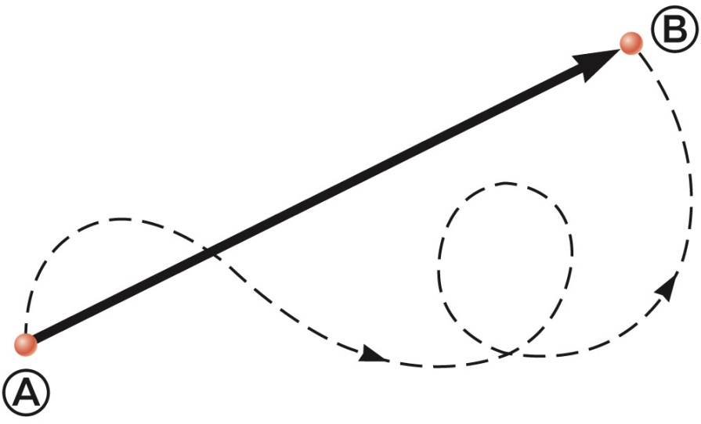
Vector Example
A particle travels from A to B along the path shown by the broken line.
  This is the distance traveled and is a scalar.
The displacement is the solid line from A to B
  The displacement is independent of the path taken between the two points.
  Displacement is a vector.

Slide 10
Quick Quiz
Which of the following are vector quantities and which are scalars?
(a) your age (b) acceleration (c) velocity
(d) speed (e) mass (f) volume (g) temperature

Slide 11
Coordinate Systems
Used to describe the position of a point in space
Common coordinate systems are:
  Cartesian (x, y, z)
  Polar (r, θ)

Slide 12
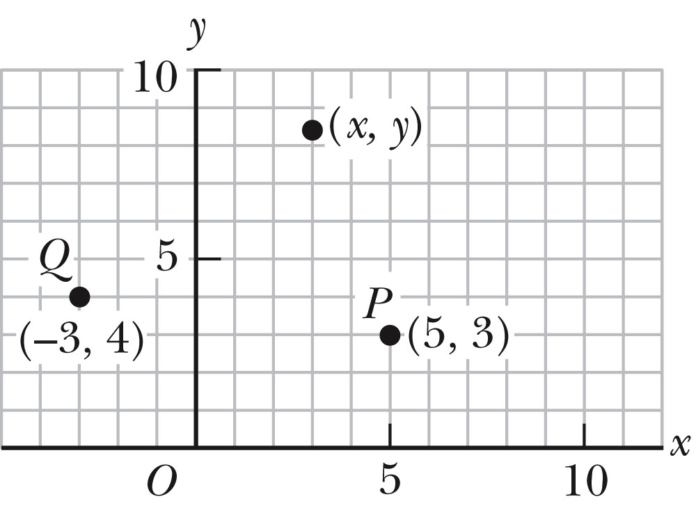
Cartesian Coordinate System
Also called rectangular coordinate system
x- and y- axes intersect at the origin
Points are labeled (x, y)

Slide 13
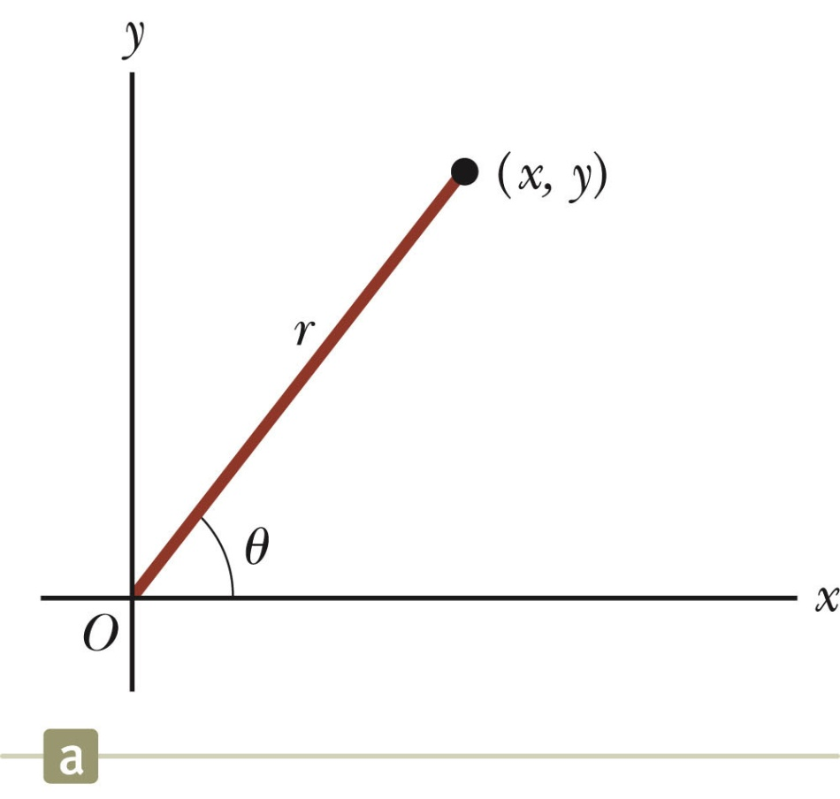
Polar Coordinate System
Origin and reference line are noted
Point is distance r from the origin in the direction of angle θ, from reference line
  The reference line is often the x-axis.
Points are labeled (r,θ)

Slide 14
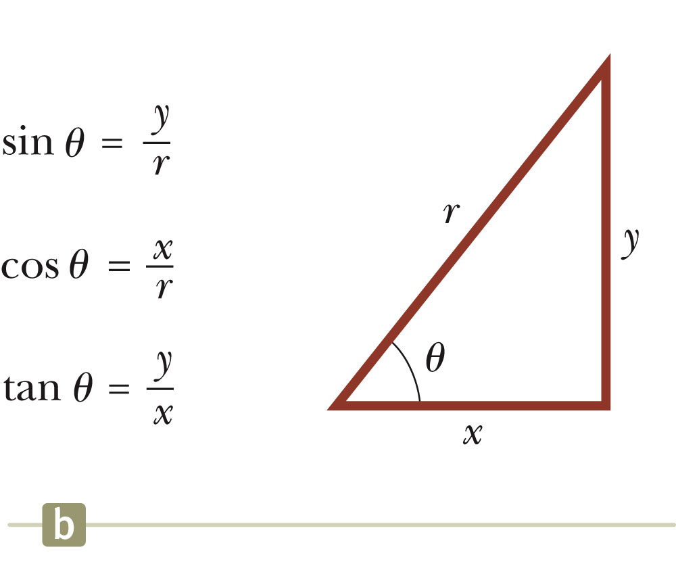
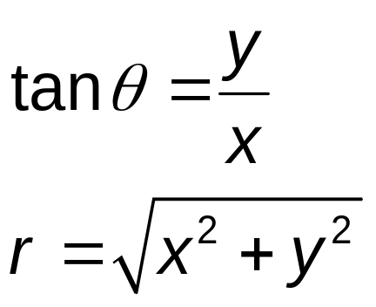
Polar to Cartesian Coordinates
Based on forming a right triangle from r and θ
x = r cos θ
y = r sin θ
If the Cartesian coordinates are known:

Slide 15
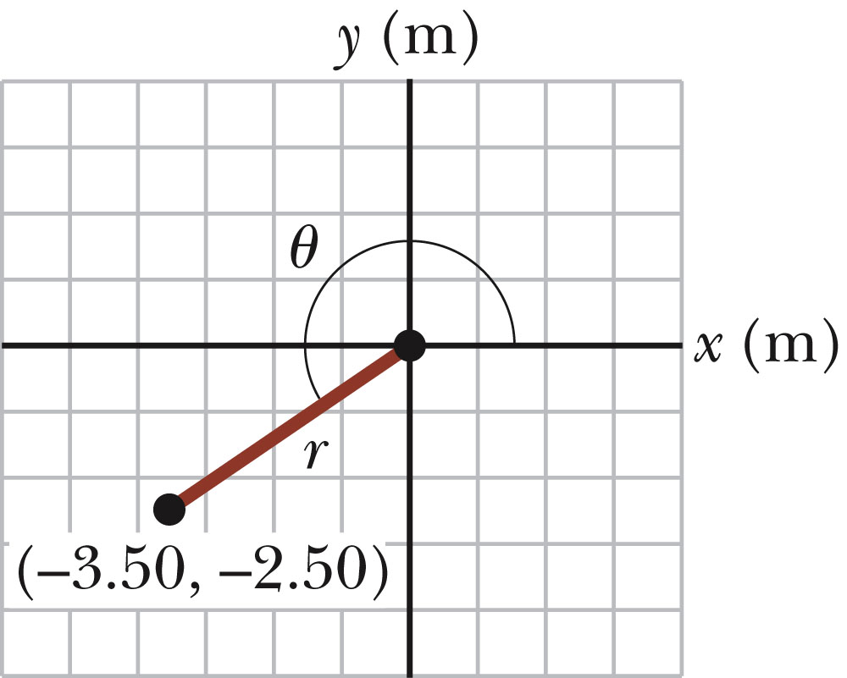
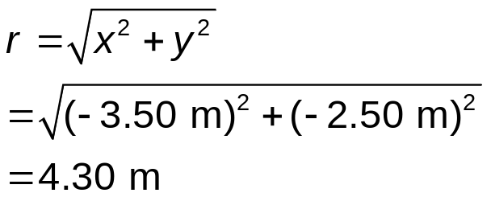
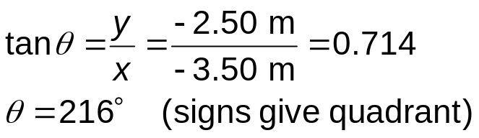
Example
The Cartesian coordinates of a point in the xy plane are (x,y) = (-3.50, -2.50) m, as shown in the figure. Find the polar coordinates of this point.
Solution:

Slide 16
Operations on /with vectors
Vector quantities can be added or subtracted using Graphical Method
Vectors can also be added by components (a necessary requirement in this course)

Slide 17
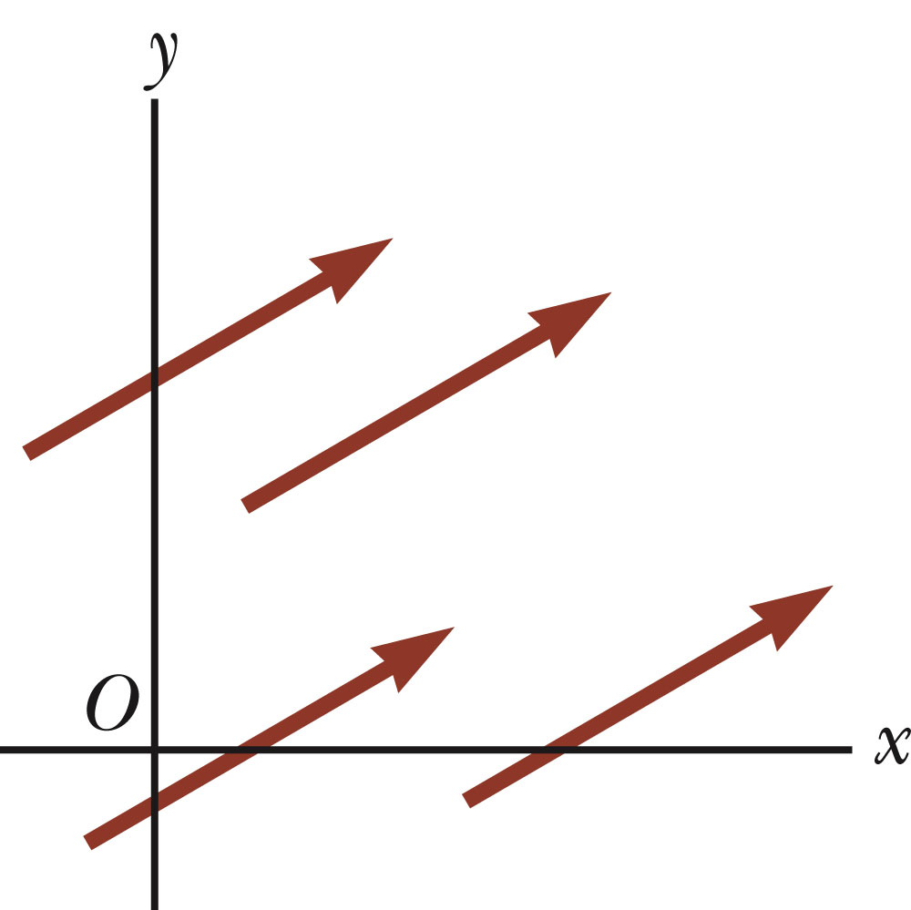

Equality of Two Vectors
Two vectors are equal if they have the same magnitude and the same direction.
if A = B and they point along parallel lines
All of the vectors shown are equal.
Allows a vector to be moved to a position parallel to itself

Slide 18
Adding Vectors
Vector addition is very different from adding scalar quantities.
When adding vectors, their directions must be taken into account.
Units must be the same
Graphical Methods require the use of scale drawings
Algebraic Methods are usually used
  More convenient

Slide 19
Adding Vectors Graphically
Choose a scale.
Draw the first vector, , with the appropriate length and in the direction specified, with respect to a coordinate system.
Draw the next vector with the appropriate length and in the direction specified, with respect to a coordinate system whose origin is the end of vector and parallel to the coordinate system used for .

Slide 20
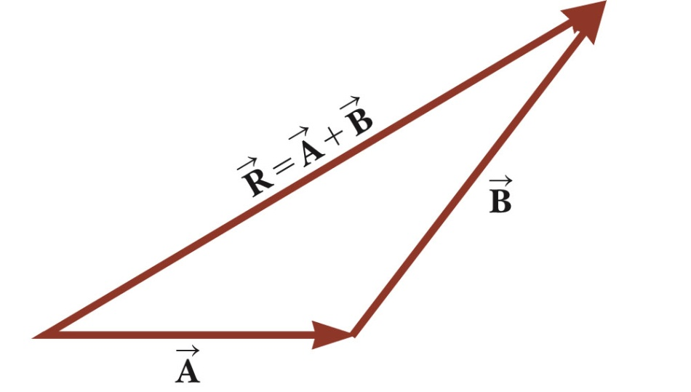
Adding Vectors Graphically, cont.
Continue drawing the vectors “tip-to-tail” or “head-to-tail”.
The resultant is drawn from the origin of the first vector to the end of the last vector.
Measure the length of the resultant and its angle.
  Use the scale factor to convert length to actual magnitude.

Slide 21
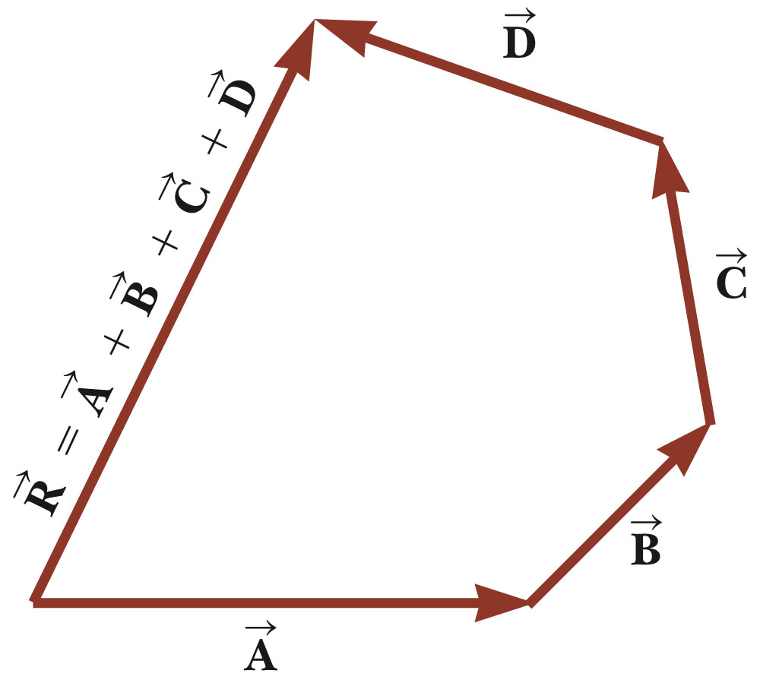
Adding Vectors Graphically, final
When you have many vectors, just keep repeating the process until all are included.
The resultant is still drawn from the tail of the first vector to the tip of the last vector.

Slide 22
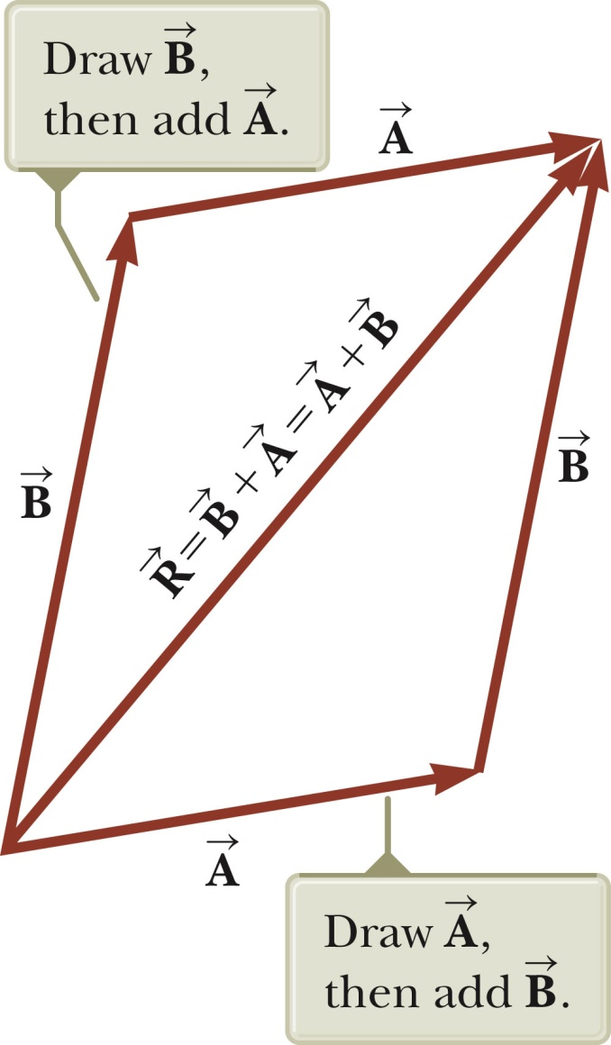
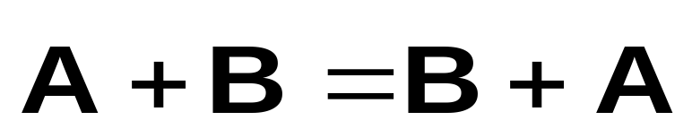
Adding Vectors, Rules
The Parallelogram Rule:
When two vectors are added, the sum is independent of the order of the addition.
  This is the Commutative Law of Addition.

Slide 23
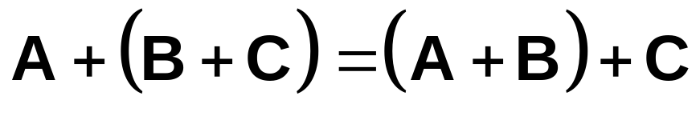
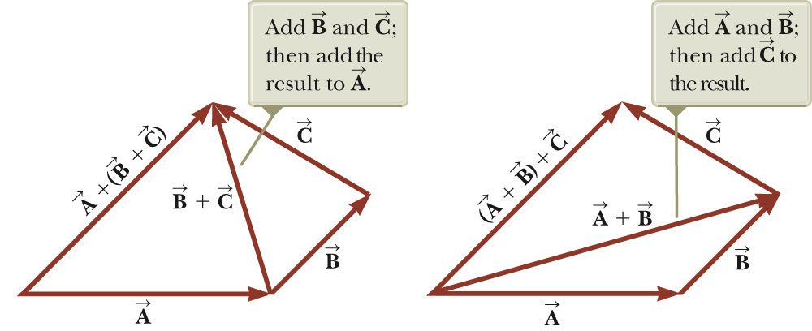
Adding Vectors, Rules cont.
When adding three or more vectors, their sum is independent of the way (order) in which the individual vectors are grouped.
  This is called the Associative Property of Addition.

Slide 24
Adding Vectors, Rules final
When adding vectors, all of the vectors must have the same units.
All of the vectors must be of the same type of quantity.
  For example, you cannot add a displacement to a velocity.

Slide 25

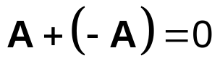
Negative of a Vector
The negative of a vector is defined as the vector that, when added to the original vector, gives a resultant of zero.
  Represented as
The negative of the vector will have the same magnitude, but point in the opposite direction.

Slide 26
Multiplying or Dividing a Vector by a Scalar
The result of the multiplication or division of a vector by a scalar is a vector.
The magnitude of the vector is multiplied or divided by the scalar.
If the scalar is positive, the direction of the result is the same as of the original vector.
If the scalar is negative, the direction of the result is opposite that of the original vector.

Slide 27
Component Method of Adding Vectors
Graphical addition is not recommended when:
  High accuracy is required
  If you have a three-dimensional problem
Component method is an alternative method
  It uses projections of vectors along coordinate axes

Slide 28
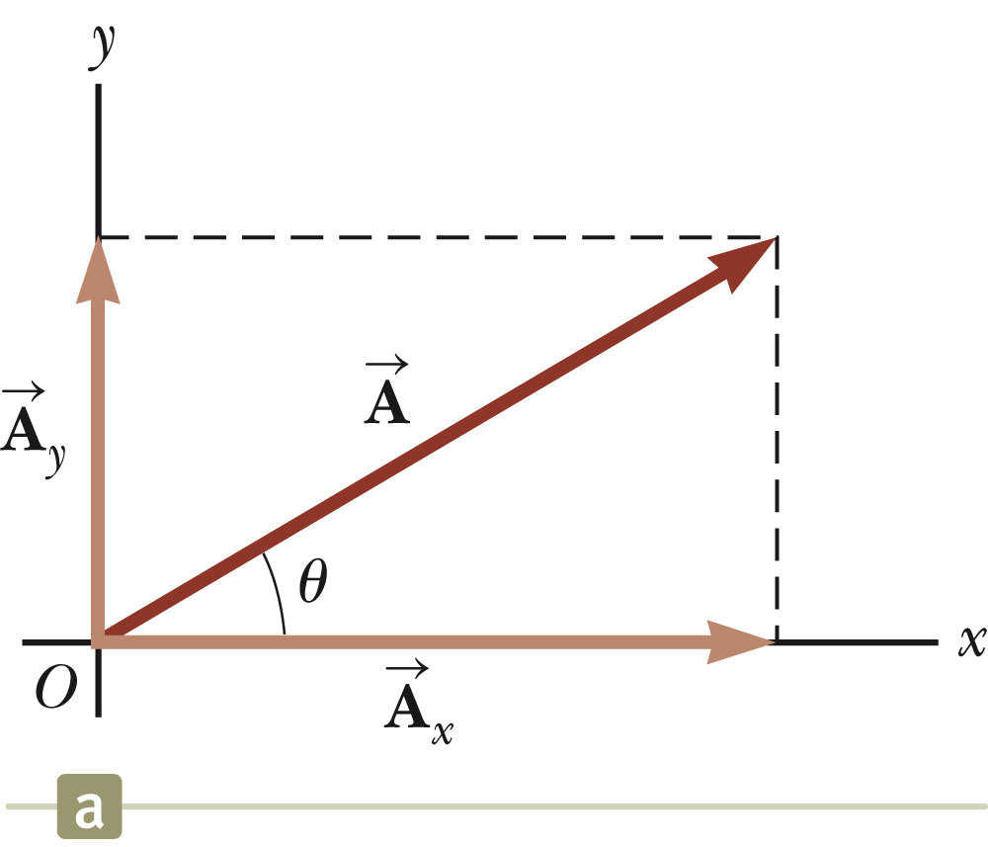
Components of a Vector, Introduction
A component is a projection of a vector along an axis.
  Any vector can be completely described by its components.
It is useful to use rectangular components.
  These are the projections of the vector along the x- and y-axes.

Slide 29

Vector Component Terminology
are the component vectors of
  They are vectors and follow all the rules for vectors.
A_{x} and A_{y} are scalars, and will be referred to as the components of .

Slide 30
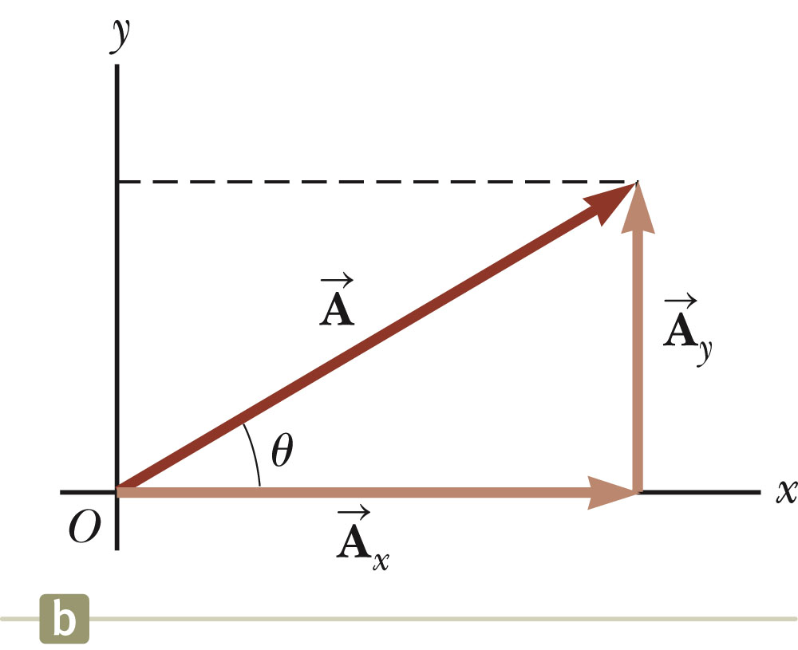



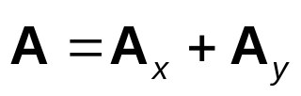
Components of a Vector
Assume you are given a vector
It can be expressed in terms of two other vectors, and
These three vectors form a right triangle.

Slide 31
Components of a Vector, 2
The y-component is moved to the end of the x-component.
This is due to the fact that any vector can be moved parallel to itself without being affected.
  This completes the triangle.

Slide 32

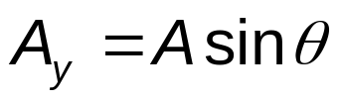
Components of a Vector, 3
The x-component of a vector is the projection along the x-axis.
The y-component of a vector is the projection along the y-axis.
This assumes the angle θ is measured with respect to the +x-axis.
  If not, do not use these equations, use the sides of the triangle directly.

Slide 33
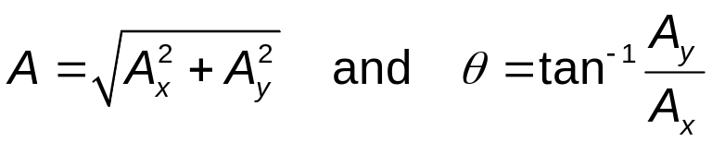
Components of a Vector, 4
The components are the legs of the right triangle whose hypotenuse is the length of A.
  May still have to find θ with respect to the positive x-axis
In a problem, a vector may be specified by its components or its magnitude and direction.

Slide 34
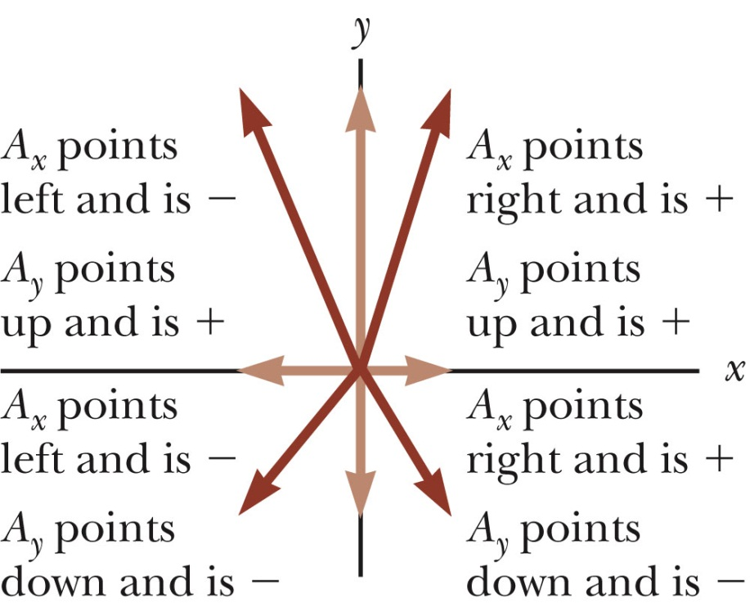
Components of a Vector, final
The components can be positive or negative and will have the same units as the original vector.
The signs of the components will depend on the angle.

Slide 35
Unit Vectors
A unit vector is a dimensionless vector with a magnitude of exactly 1.
Unit vectors are used to specify a direction and have no other physical significance.

Slide 36

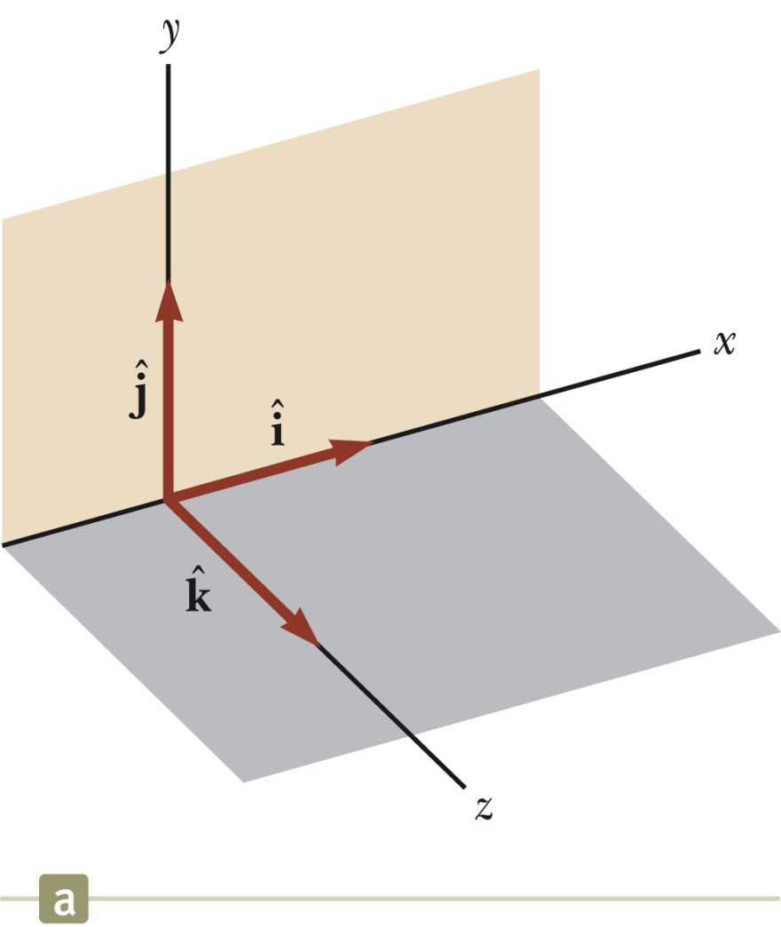
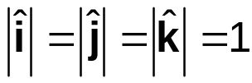
Unit Vectors, cont.
The symbols
represent unit vectors
They form a set of mutually perpendicular vectors in a right-handed coordinate system
The magnitude of each unit vector is 1

Slide 37
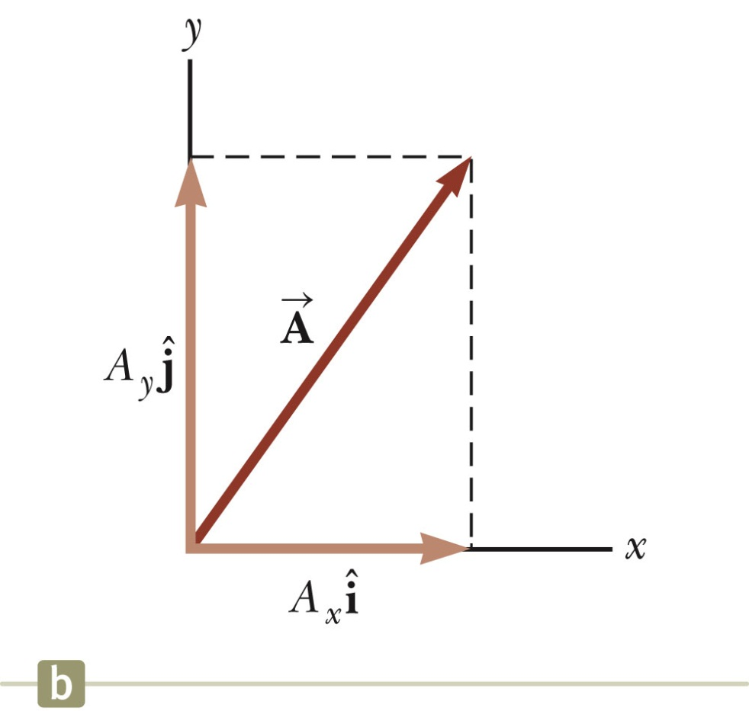
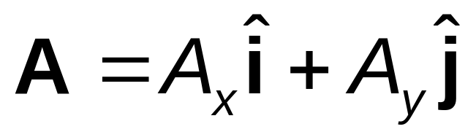
Unit Vectors in Vector Notation
A_{x} is the same as A_{x} and A_{y} is the same as A_{y} etc.
The complete vector can be expressed as:

Slide 38
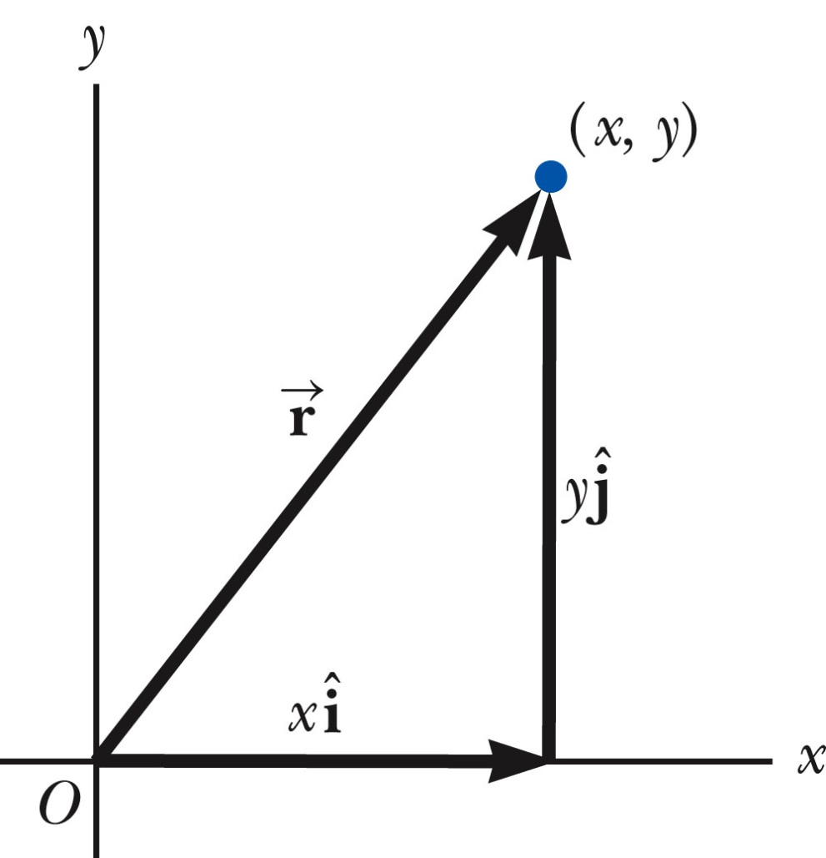
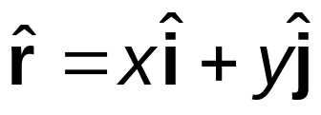
Position Vector, Example
A point lies in the xy plane and has Cartesian coordinates of (x, y).
The point can be specified by the position vector.
This gives the components of the vector and its coordinates.

Slide 39
Problem
Find the sum of two displacement vectors A and B lying in the xy plane and given by:
A = (2.0 i + 2.0 j)m
B = (2.0 i - 4.0 j)m

Slide 40

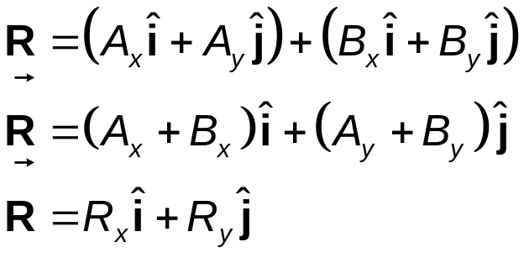
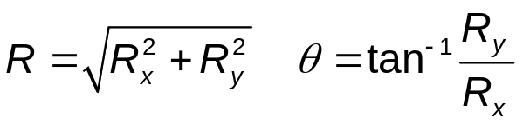
Adding Vectors Using Unit Vectors
Using
Then
So R_{x} = A_{x} + B_{x} and R_{y} = A_{y} + B_{y}

Slide 41
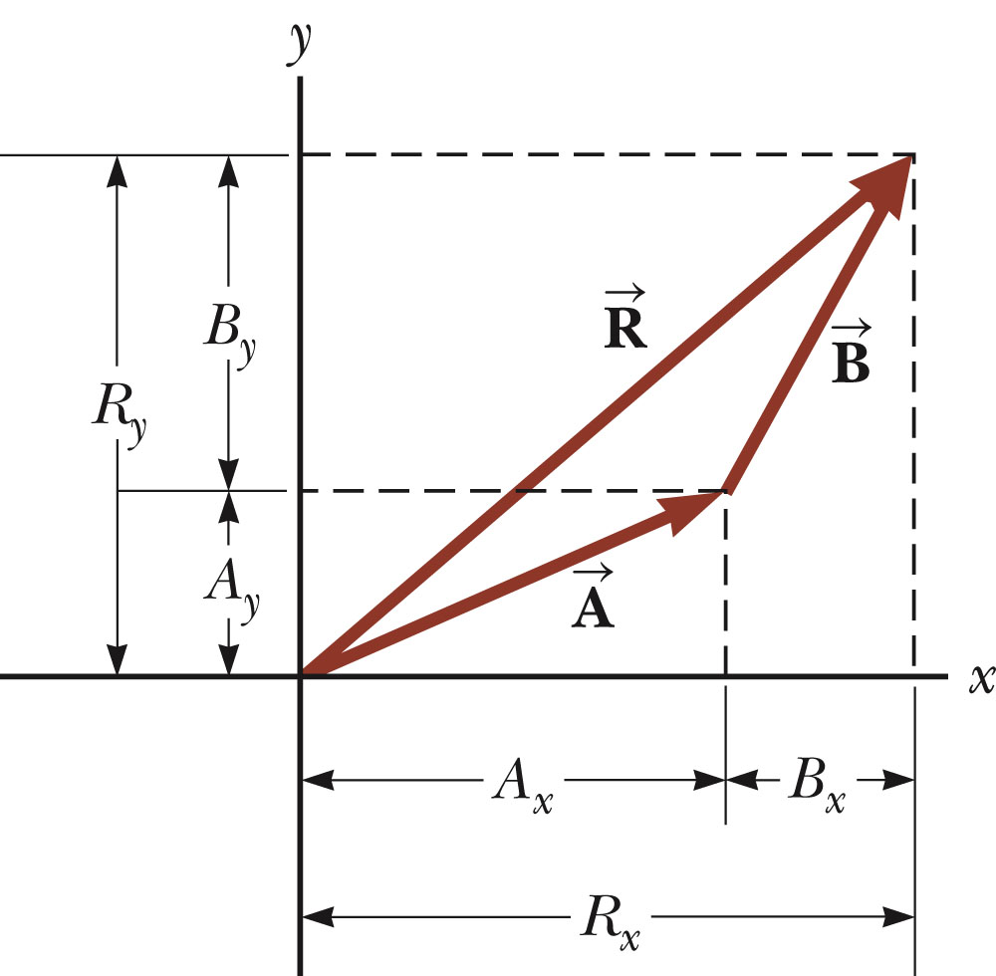
Adding Vectors with Unit Vectors
Note the relationships among the components of the resultant and the components of the original vectors.
R_{x} = A_{x} + B_{x}
R_{y} = A_{y} + B_{y}

Slide 42
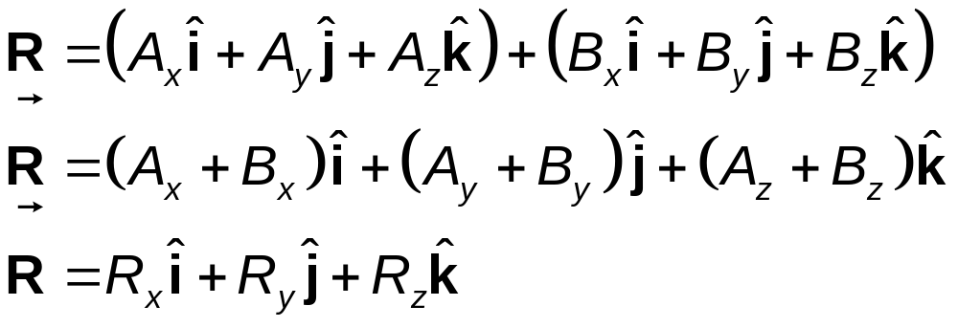
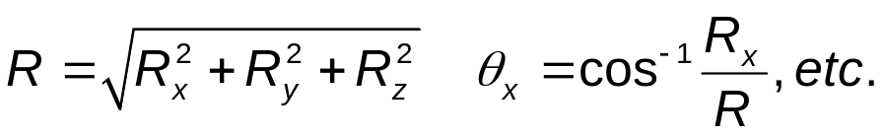
Three-Dimensional Extension
Using
Then
So R_{x}= A_{x}+B_{x}, R_{y}= A_{y}+B_{y}, and R_{z} = A_{z}+B_{z}

Slide 43

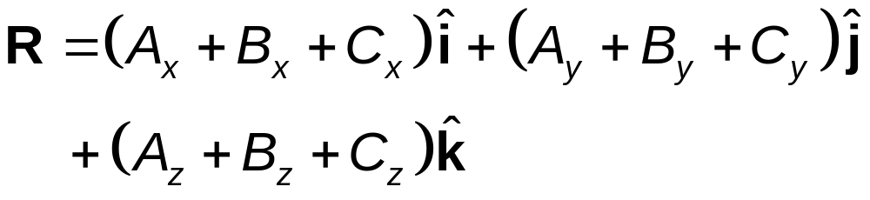
Adding Three or More Vectors
The same method can be extended to adding three or more vectors.
Assume
And

Slide 44
Multiplication of Vectors
Scalar or Dot Product
Vector or Cross Product

Slide 45
Projectile Motion
An object may move in both the x and y directions simultaneously.
The form of two-dimensional motion we will deal with is called projectile motion.

Slide 46
Assumptions of Projectile Motion
The free-fall acceleration is constant over the range of motion.
  It is directed downward.
The effect of air friction is negligible.
With these assumptions, an object in projectile motion will follow a parabolic path.
  This path is called the trajectory.

Slide 47
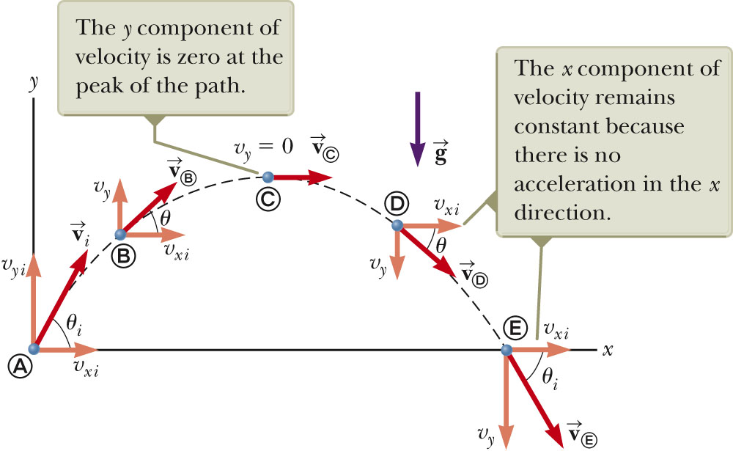
Projectile Motion Diagram

Slide 48
Acceleration at the Highest Point
The vertical velocity is zero at the top.
The acceleration is not zero anywhere along the trajectory.
  If the projectile experienced zero acceleration at the highest point, its velocity at the point would not change.
    The projectile would move with a constant horizontal velocity from that point on.

Slide 49
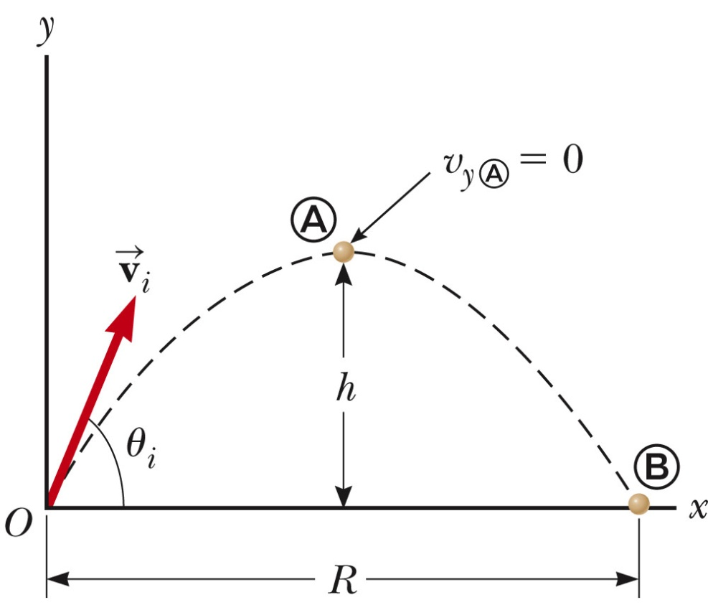
Range and Maximum Height of a Projectile
When analyzing projectile motion, two characteristics are of special interest
The range, R, is the horizontal distance of the projectile.
The maximum height the projectile reaches is h.

Slide 50
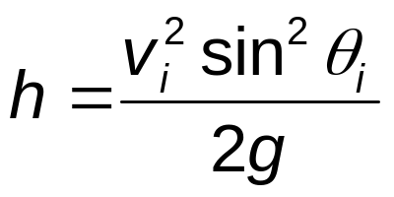
Height of a Projectile, equation
The maximum height of the projectile can be found in terms of the initial velocity vector:
This equation is valid only for symmetric motion.

Slide 51
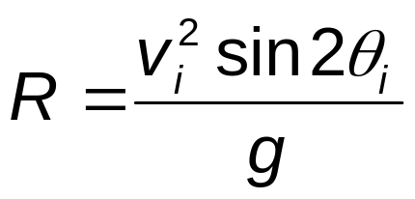
Range of a Projectile, equation
The range of a projectile can be expressed in terms of the initial velocity vector:
This is valid only for symmetric trajectory.

Slide 52
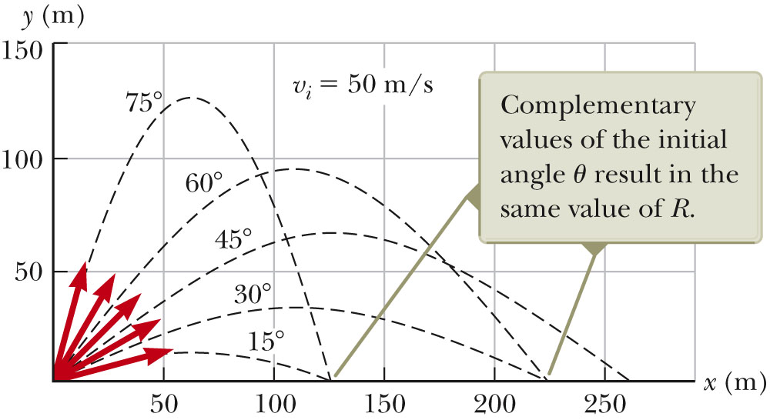
More About the Range of a Projectile

Slide 53
Range of a Projectile, final
The maximum range occurs at θ_{i} = 45º .
Complementary angles will produce the same range.
  The maximum height will be different for the two angles.
  The times of the flight will be different for the two angles.

Slide 54
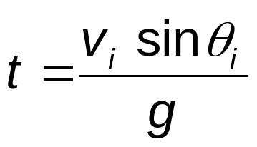
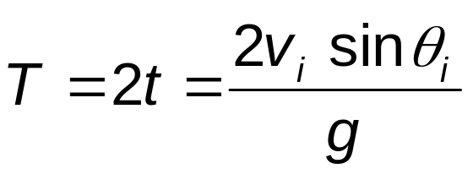
Time of Flight
The time taken to reach the maximum height is
Total time of travel (for symmetric paths)
Note: The Range R can also be determined using the time of travel

Slide 55
Projectile Motion – Problem Solving Hints
Conceptualize
  Establish the mental representation of the projectile moving along its trajectory.
Categorize
  Confirm air resistance is neglected.
  Select a coordinate system with x in the horizontal and y in the vertical direction.
Analyze
  If the initial velocity is given, resolve it into x and y components.
  Treat the horizontal and vertical motions independently.

Slide 56
Problem
A long jumper leaves the ground at an angle of 20.0° above the horizontal and at a speed of 11.0 m/s
How far does he jump in the horizontal direction?
What is the maximum height reached?
How long does it take to reach the maximum height?
What is the time taken for the entire jump?

Slide 57
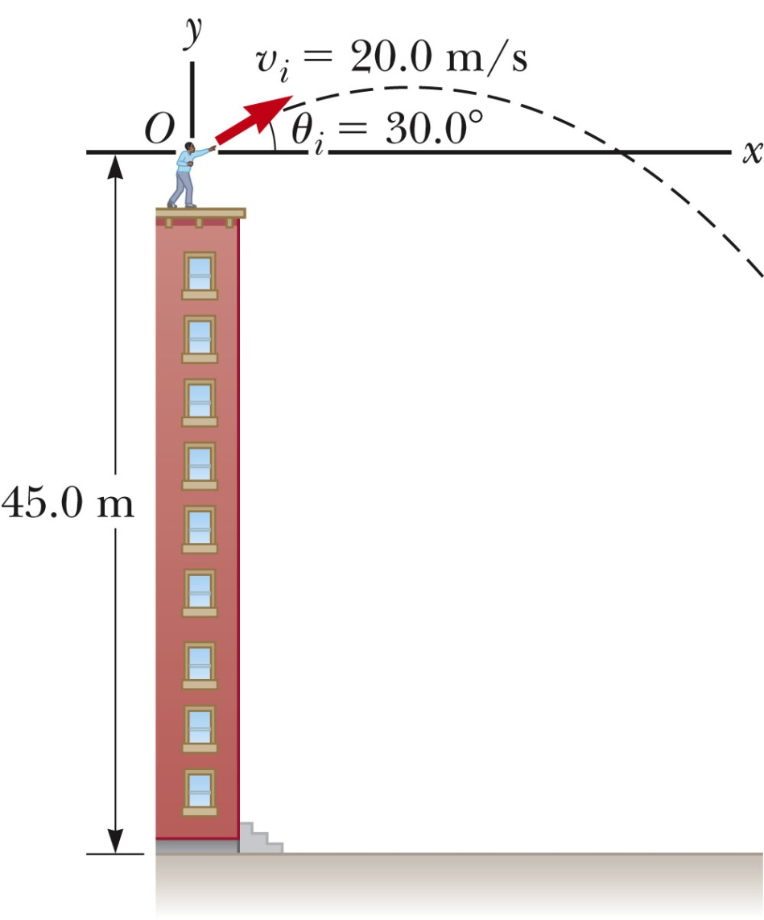
Non-Symmetric Projectile Motion
Follow the general rules for projectile motion.
Break the y-direction into parts.
  up and down or
  symmetrical back to initial height and then the rest of the height
Apply the problem solving process to determine and solve the necessary equations.
May be non-symmetric in other ways

Slide 58
Problem
A stone is thrown from the top of a building upward at an angle of 30.0° to the horizontal with an initial speed of
20.0 m/s. The height from which the stone is thrown is 45.0 m above the ground.
How long does it take the stone to reach the ground?
What is the speed of the stone just before it strikes the ground?

Slide 59
Problems
1. A stone is thrown from the top of a building with an initial velocity of 20 m/s downward. The top of the building is 60 m above the ground. How much time elapses between the instant of release and the instant of impact with the ground?
Ans: 6s
2. A ball thrown vertically from ground level is caught 3.0 s later when it is at its highest point by a person on a balcony which is 14 m above the ground. Determine the initial speed of the ball.
Ans: 19.7 m/s

